Slide 1
On Machine Reading Comprehension and Question Answering
Wei Zhang, Yang Yu, Bowen Zhou
RCQA Squad, IBM Watson
Nov. 21, 2016 @Harvard NLP

Slide 2
Overview
RCQA as inference task in an ideal scenario
RCQA in a real world single passage scenario
RCQA in a multi-passage scenario
Remaining Challenges
easier
harder

Slide 3
Overview
RCQA as inference task in an ideal scenario
RCQA in a real world single passage scenario
RCQA in a multi-passage scenario
Remaining Challenges

Slide 4
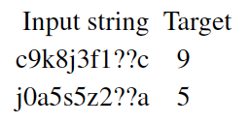
RCQA as inference task in an ideal scenario
Tasks:
1） Associative Recall
2） bAbI dataset (Weston et al. 2015)
An excerpt from bAbI dataset
1 John travelled to the hallway.
2 Mary journeyed to the bathroom.
3 Where is John? hallway 1 4 Daniel went back to the bathroom.
5 John moved to the bedroom.
6 Where is Mary? bathroom 2
task (1): Single supporting fact
F: Mary went to the Kitchen.
Q: Where is marry?
A: Kitchen.
task (2): two supporting facts
F: John got the football there.
F: John went to the hallway.
Q: Where is the football?
A: Hallway
task (3): three supporting facts
F: Mary journeyed to the office.
F: Mary journeyed to the bathroom.
F: Mary dropped the football.
Q: Where was the football before the bathroom?
A: office

Slide 5
RCQA as inference task in an ideal scenario
Model:
Structured Memory NTM (Zhang et al., 2015, NIPS RAM workshop)
next page
Neural Machine Translation (Yu et al., 2015)
Concatenate passage and question, feed into words into encoder. Decode single token answer. (87% acc. on bAbI 10K, v.s. ~100% so far)

Slide 6
Structured Memory for Neural Turing Machines
Memory visability (w.r.t. write heads): memory is ‘Controlled’ if it is modified by controller outputs through write heads directly, or ‘Hidden’ if not.
1. Hidden-memory
2. Double-controlled
3. Tightly-coupled
input
output
input
output
input
output
LSTM
LSTM
LSTM L1
w
r
w1
w2
r
LSTM L2
Mc
M1
wL1
wL2
r
M2
M1
Mh
M2

Slide 7
Vanilla NTM
output:
input:
output:
input:
Output
Output
c(t-1)
c(t)
LSTM
LSTM
c(t-1)
c(t)
ADDRESSING
READ
ADDRESSING
M (t-1)
M(t)

Slide 8
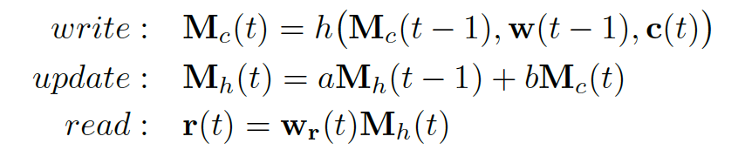
#1: Hidden-Memory NTM
output:
input:
output:
input:
Output
Output
c(t-1)
c(t)
LSTM
LSTM
c(t-1)
c(t)
ADDRESSING
READ
ADDRESSING
Mc (t-1)
Mc (t)
acc
acc
Mh (t-1)
Mh (t)

Slide 9
#2: Double-Controlled NTM
output:
input:
output:
input:
Output
Output
c(t-1)
c(t)
LSTM
LSTM
c(t-1)
c(t)
ADDRESSING
ADDRESSING
ADDRESSING
ADDRESSING
READ
M1(t-1)
M1(t)
acc
acc
M2(t-1)
M2(t)

Slide 10
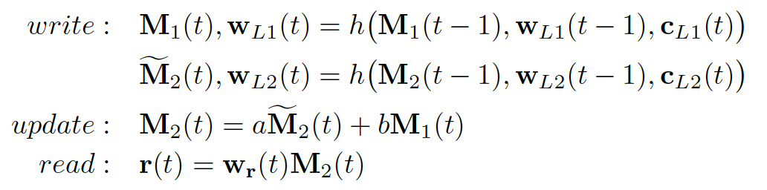
#3 Tightly-Coupled NTM
NTM output:
NTM input:
Output
L1
c(t)
Multi-layer LSTM
L2
L3
ADDR1
ADDR2
ADDR3
M1
M2
M3

Slide 11
Associative Recall (x-axis is # of iterations, y-axis is log of NLL loss/vector, sampled every 25 iters)

Slide 12
Associative Recall (x-axis is # of iterations, y-axis is log of NLL loss/vector, sampled every 25 iters)

Slide 13
bAbI task 1 (1K) supporting fact only
x #epochs, y acc.

Slide 14
bAbI task 2 (1k train/test) supporting fact only
x #epochs, y acc.

Slide 15
Task 3(1K) Accuracy
x #epochs, y acc.

Slide 16
Overview
RCQA as inference task in an ideal scenario
RCQA in a real world single passage scenario
RCQA in a multi-passage scenario
Remaining Challenges

Slide 17
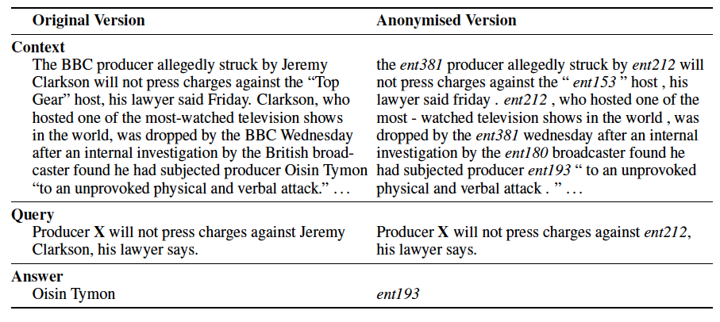
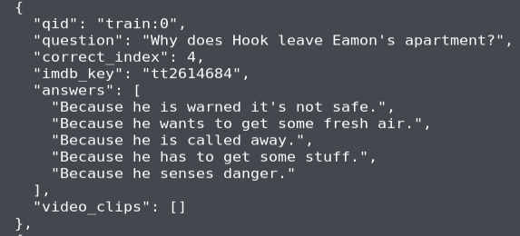
Quiz and Cloze Style Question Answering
MC Test / Movie QA
Complexity is 4-5
CNN/DailyMail/CBT
Complexity is 30 to 40

Slide 18
Attention Sum Reader (Kadlec et. al 2016)

Slide 19
Attention Sum Reader (Kadlec el. al 2016)
CBT Results
CNN/Daily Mail Results

Slide 20
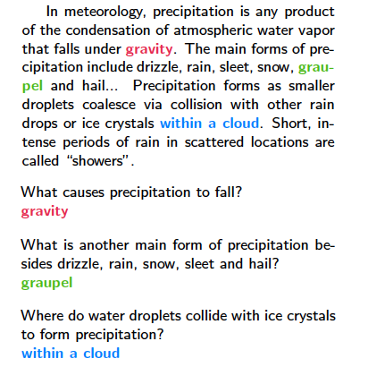
Stanford Question Answering Dataset (SQuAD)
Answer is a span of text in any length
Complexity of choosing candidates is O(n^2), n is passage length which is often over 1000
86k Train / 10k Dev

Slide 21
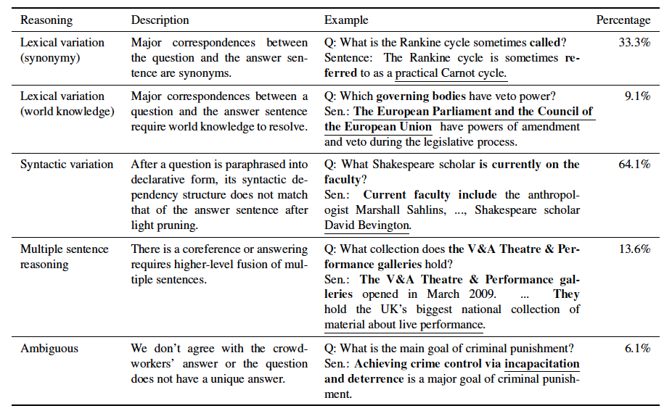
SQuAD

Slide 22
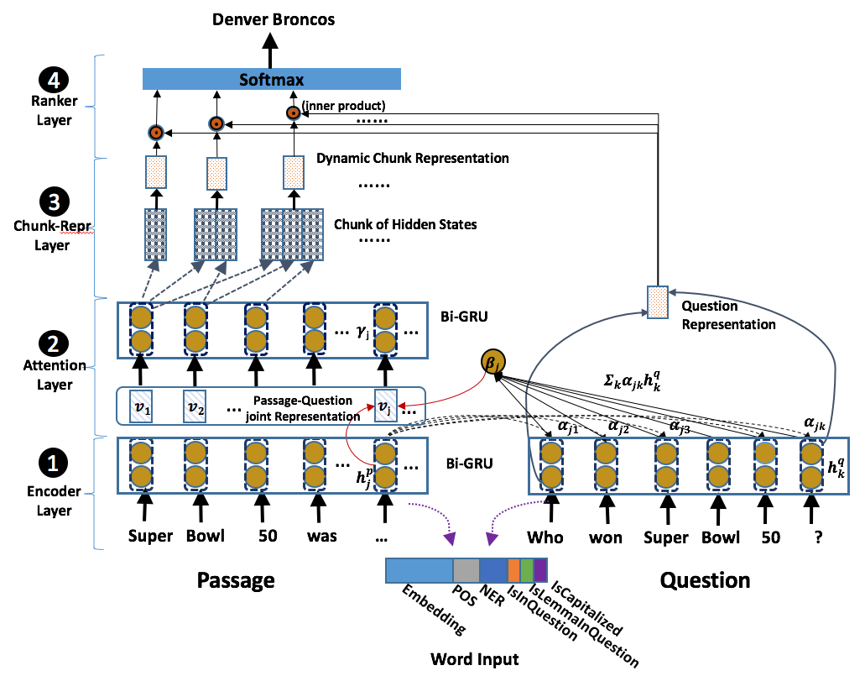
Dynamic Chunk Reader

Slide 23
Leaderboard (as of Sept 15)
 | Dev |  | Test
 | EM | F1 | EM | F1
Logistic Regression (Stanford) | 40.0 | 50.0
MatchLSTM (SMU) | 59.1 | 70.0 | 59.5 | 70.3
DCR (IBM) | 62.5 | 71.2 | 62.5 | 71.0

Slide 24
Result Analysis
Variations of DCR performance on ground truth answer length (up to 10) in the development set.
Performance of the DCR across question types.

Slide 25
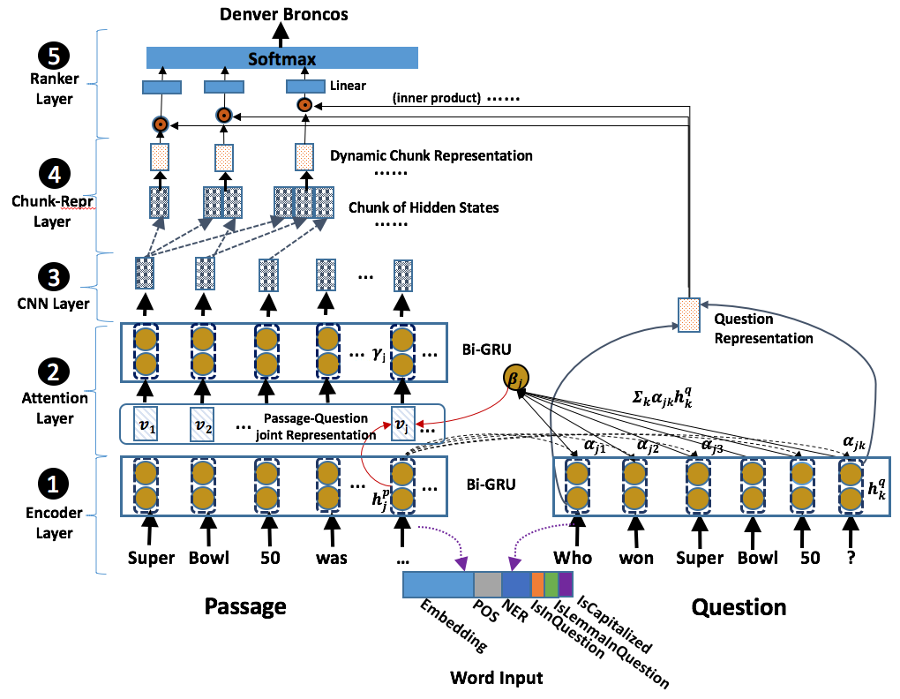
Dynamic Chunk Reader v2

Slide 26
Leaderboard (as of Nov. 14)
 | Dev |  | Test
 | EM | F1 | EM | F1
MatchLSTM (SMU) | 64.1 | 73.9
MatchLSTM ensemble (SMU) | 67.6 | 76.8 | 67.9 | 77.0
Span Classifier (Google) | 66.4 | 74.9
Span Classifier ensemble (Google) | 68.2 | 76.7
Bi-attention (AI2) | 64.0 | 74.5
Bi-attention ensemble (AI2) | 69.2 | 77.8 | 69.9 | 78.1
Co-attention (Salesforce) | 65.4 | 75.6
Co-attention ensemble (Salesforce) | 70.3 | 79.4 | 71.2 | 80.4
DCR v2 (IBM) | 63.6 | 72.5
DCR v2 ensemble (IBM) | 66.3 | 74.7

Slide 27
Overview
RCQA as inference task in an ideal scenario
RCQA in a real world single passage scenario
RCQA in a multi-passage scenario
Remaining Challenges

Slide 28
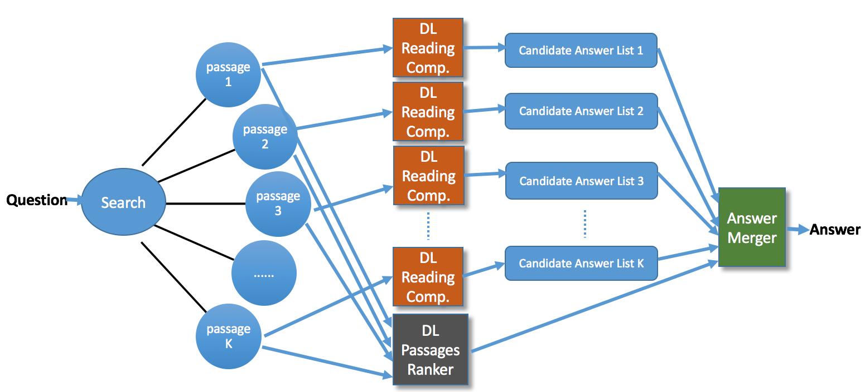
Multi-passage Factoid QA
In real world scenario, only question is provided.

Slide 29
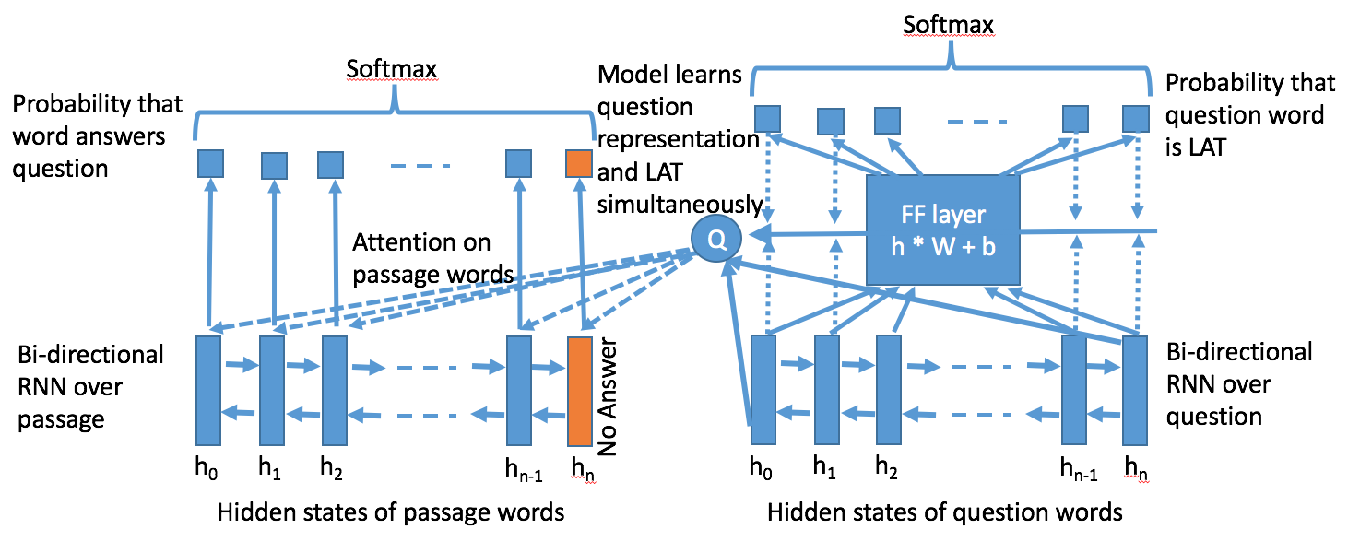
RC on single document

Slide 30
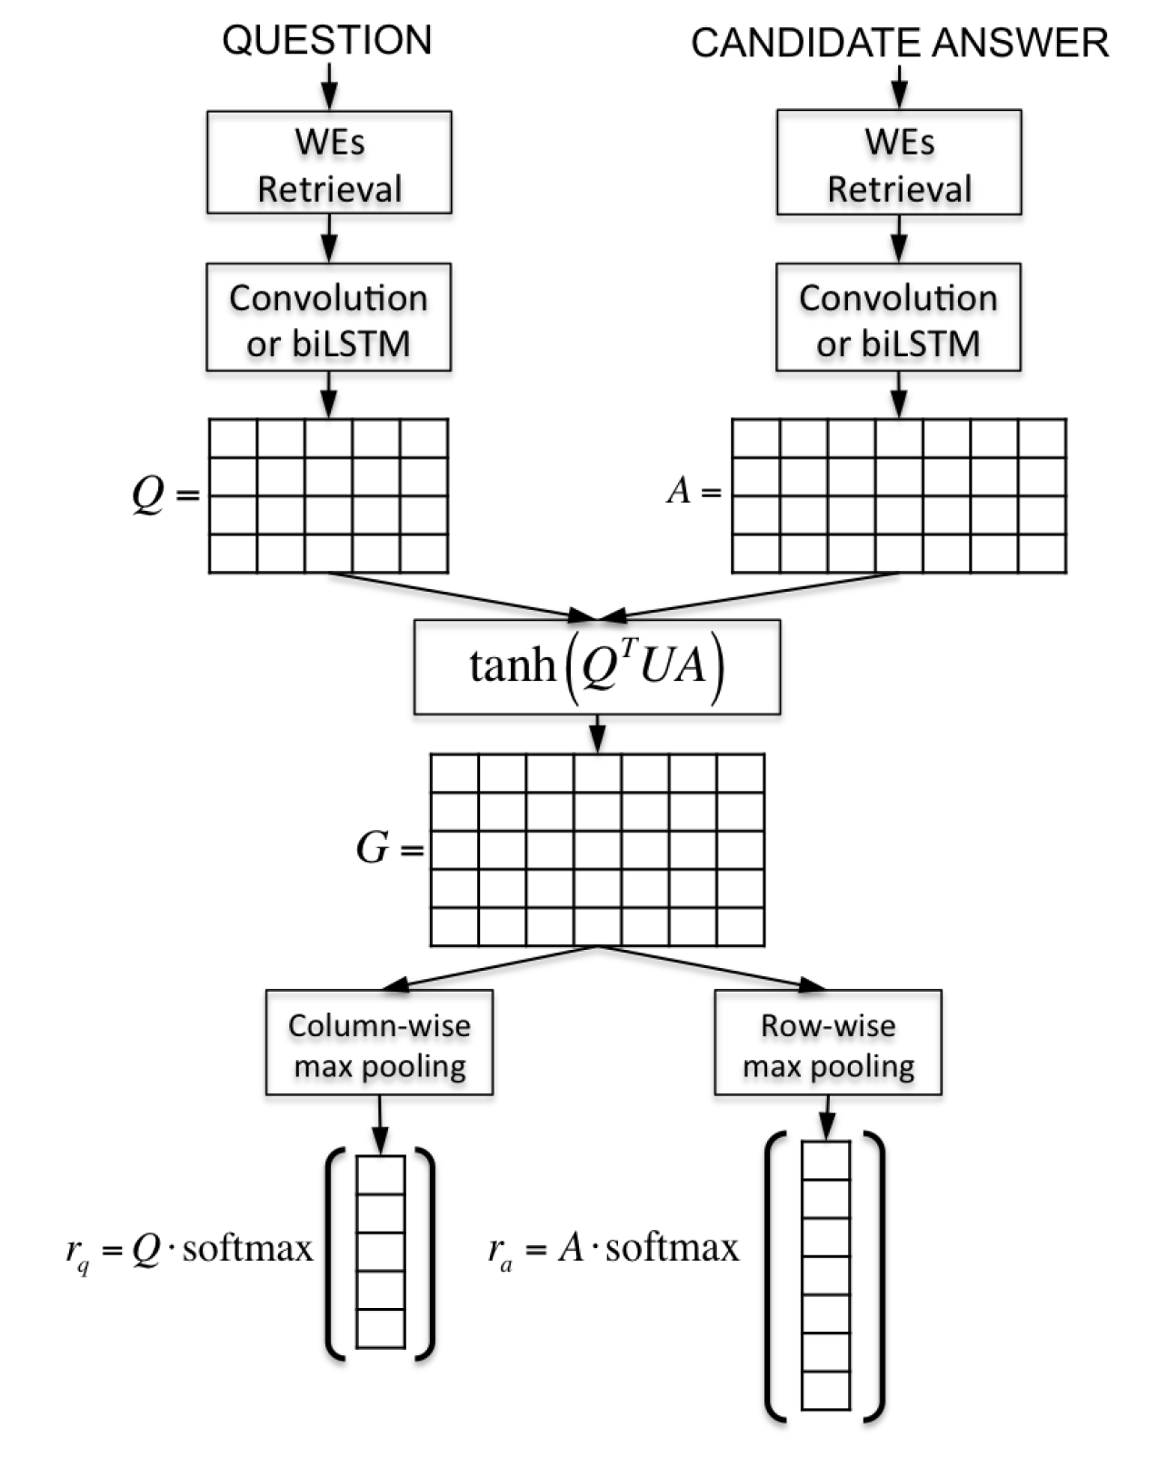
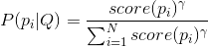
Retrieved Pasasge ranking with
Attentive Pooling-Convolutional
Neural Networks
Passage i
Question
(Cicero et al. 2016)
Assumption: Each of the retrieved passage i is evaluated by its similarity to the question, using AP-CNN. The more similar the question is to the passage, the more relevant the passage is to the question, and in turn the more trust we put to the passage for generating the correct answer.
APCNN uses the two-way attention mechanism between passage words and question words for evaluating similarities. For passage i for the question Q, we first generate similarity score score(P_i). After all scores are generated, the scores are then normalized to a distribution with sharpening parameter .
Pi
Q
Tanh(P^{T}UQ)
Pi
Q
Besides APCNN, we also used DDQA passage ranking scores altogether to indicate relevance of the passage.

Slide 31
IBM Internal Real User Question Answering
Module combinations | Accuracy on validation
RC | 31.75%
RC+ heuristics | 33.09%
RC+APCNN | 35.85%
RC+APCNN+entail | 36.32%
RC+APCNN+DDQA passage scores | 36.91%

Slide 32
Joint cost = Attention sum loss + Margin ranking loss
Model 1:
Model 2 :
Joint cost = Attention sum loss + Margin ranking loss
attention sum loss
softmax
Margin ranking loss
(using a true psg and a false psg)
Margin ranking loss
(using a true psg and a false psg)
attention sum loss
softmax
P
Q
Bi-GRU
Bi-GRU
Bi-GRU
Passage
Bi-GRU
Question
Average pooling as passage representation
Attention Max among all outputs as passage score

Slide 33
Joint Learning RC and Passage ranking
two strategies for passage score using
only scores from bi-encoder:
max token score in passage
Avg pooling of scores from bi-encoder
Attentive Pooling scores from bi-encoder
The final scores are only evaluating RC
part.
Max word score or avg. pooling scores
can be used as passage scores.

Slide 34
Overview
RCQA as inference task in an ideal scenario
RCQA in a real world single passage scenario
RCQA in a multi-passage scenario
Remaining Challenges

Slide 35
Remaining Challenges
Learning representation
new RNN/CNN models
more labeled/unlabeled data
dataset creation
Effective alignment between representations

Slide 36
At last,
Collaboration is Welcome，
And, we are hiring
internship/full-time candidates
Contact Sasha or us, if interested.
Topics we care about:
Innovative NN models, reinforcement Learning for NLP, machine reading comprehension, answer generation, knowledge graph based QA, semantic relatedness

Slide 37
Questions

Slide 38
Reference
Dzmitry Bahdanau, Kyunghyun Cho, and Yoshua Bengio. Neural machine translation by jointly learning to align and translate. ICLR , 2015.
Karl Moritz Hermann, Tomas Kocisky, Edward Grefenstette, Lasse Espeholt, Will Kay, Mustafa Suleyman, and Phil Blunsom. Teaching machines to read and comprehend. In Advances in Neural Information Processing Systems , pp. 1693–1701, 2015.
Felix Hill, Antoine Bordes, Sumit Chopra, and Jason Weston. The goldilocks principle: Reading children’s books with explicit memory representations. arXiv preprint arXiv:1511.02301 , 2015.
Rudolf Kadlec, Martin Schmid, Ondrej Bajgar, and Jan Kleindienst. Text understanding with the attention sum reader network. ACL , 2016.
Pranav Rajpurkar, Jian Zhang, Konstantin Lopyrev, and Percy Liang. Squad: 100,000+ questions for machine comprehension of text. arXiv preprint arXiv:1606.05250 , 2016.
Matthew Richardson, Christopher JC Burges, and Erin Renshaw. Mctest: A challenge dataset for the open-domain machine comprehension of text. In EMNLP , volume 3, pp. 4, 2013.

Slide 39
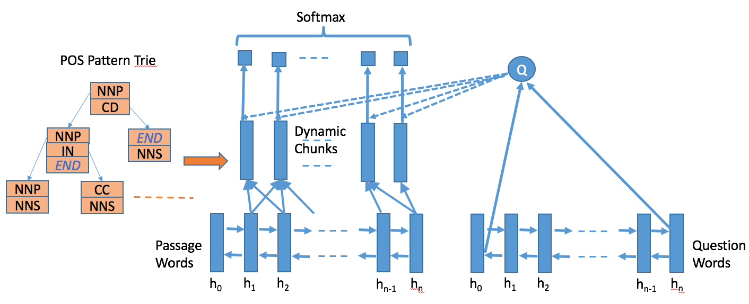
Dynamic Chunk Reader v1

